Slide 1
Singapore Tourism Board Analysis
Alvin Lim

Slide 2
Overview
Background information
Problem statements
Technical
Non-technical
Recommendations
Notes:
Since the questions given in the assignment focuses on technical aspects but also require me to present the insights to a marketing team, who I assume is a non technical audience. I have ordered my presentation where by I can answer technical aspects such as explaining issues with the data etc. and what features I have created to achieve my analysis.
After which, I will show various illustration created to show to the non technical audience what insights I have found, and lastly some recommendations for Singapore Tourism Board’s marketing team on their strategy to increase visitorship and spend in Singapore

Slide 3
Background information
The dataset provided contains the following:
Year, month
Purpose of visit
Mode of transport
Length of stay
Travel type (Packaged vs. non packaged tour)
Martial Status
Occupation
Shopping and other expenses
Whether they travelled alone
Notes:
Singapore tourism sector is growing at a fast pace. Tourism is not only a kind of leisure as it is also essential in a country's economy. In this analysis, I investigate Singapore’s tourist spending behaviours and preferences.
Firstly, I will go through give a quick run-through about what the dataset is about. The dataset used in this presentation is from 2018, it contains all of these variables.

Slide 4
Problem statements
Understand Singapore’s tourist spending behaviours and preferences
Is there a strong or weak relationship between travel companions and choice of hotel?
How many different segment of visitors can be identified from the survey data

Slide 5
Technical - Workflow
Step 3: Impute/remove missing values and transforming of variables
Step 1: Import data using CSV format
Step 5: Briefly summaries and provide insights
Import data
Descriptive data
Data Transformation
Use of clustering
Analyze
Step 2: Understanding the data structure and variable type
Step 4: Select various features to cluster the data
Notes:
Describe the analytical approach you will take and data fields you would look into when it comes to doing exploratory data analysis.
Highlight the data idiosyncrasies / issues you found in this dataset and how would you address the issues identified.
What are the considerations that you will take when analysing survey data.

Slide 6
Technical - Key issues with the dataset
Variable | Issues | Example
Air_Terminal, Sea_Terminal, Land_Terminal | There are 3 cases where mode of travel is not recorded | Cases 695, 806, 819 have missing mode of travel
MainHotel | There is a discrepancy | 6688 cases of MainHotel had missing data 7028 cases of c4a_1 had missing data
avg_daily_expense df_cleaned['tot.exp'] / df_cleaned['Length of Stay_fixed'] | Outliers in spending | There were people who didn’t spend any money and max spending was 22959
Travel companion columns | There are cases where who they are travelling with is not recorded | Family 11779 Alone 5703 Not stated 4363 Business 920 Others 194
Length of stay varies significantly | There are cases uneven sample | People staying from days ranging from 0 to 60 days
15 variables | Missing values found in 15 variables | Examples include some shopping variables, purpose of visit

Slide 7
Technical - How key issues were resolved
Variable | Issues | Solution
Air_Terminal, Sea_Terminal, Land_Terminal | There are 3 cases where mode of travel is not recorded | Deleted the 3 cases
MainHotel | There is a discrepancy between MainHotel and c4a_1 | Did not used these columns as they were not central for my analysis
avg_daily_expense df_cleaned['tot.exp'] / df_cleaned['Length of Stay_fixed'] | Outliers in spending | Where the 0 days stayed was converted to 1, this is to allow the calculation to be calculated correctly
Travel companion columns | There are cases where who they are travelling with is not recorded | A 2 new columns was created to take into account these issues
Length of stay | People who stay | Grouped length on stay into 3 categories – short stay, medium stay, and long stay
shopping_fash, shopping_food, shopping_gifts, shopping_others, shopping_any | Missing values for these variables | K nearest neighbours to impute the variables

Slide 8
Technical - Segmentation of tourist
Model 1: K means clustering
To understand how are these tourist categorised in terms spending differences and what they spend most on
Model 2: K prototype clustering
To understand how are these tourist categorised in terms spending differences and also to profile these tourists
Notes:
Tourist spending patterns can be segmented meaningfully based on their shopping behavior. The use of kmeans and kprototype helped identify distinct spending groups.
Why is your analytical approach performing well / not well?
It is noted that quite a number of spenders were considered as outliers, big spender can pull the cluster center away, making the average misleading. KMeans and kprototype works by finding averages (centroids) of different groups.
Other clustering methods like Hierarchical and DBSCAN, but they were not well-suited for mixed data or large volumes.
My approach worked well in producing interpretable segments, as an initial understanding of the dataset it is sufficient to understand the data before doing any form of regression to further understand the data

Slide 9
Features used in clustering
Kmeans clustering
Kprototype clustering
Spending (Numerical variables ) - Scaled
Shopping – Fashion, Jewellery, Watches, Wellness, Food, Gifts & Souvenirs, Consumer Electronics, Antiques, Others, Any Category;
Total – Accommodation, Food & Beverage, Transport, Business Services, Education, Medical Services, Others, Reported Shopping, Total Expenditure, Average Daily Expense
Feature engineering variables
Average Daily Expenses
Variables of interest (Categorical variables)
'Stay_Length_string', 'travel_with', 'occupation_coded_string'
Notes:
I select a baseline model and a Xgboost model for analysis (the reason why I select Xgboost model is because it is better at handling imbalance classes)
For e.g. in the factory.csv I used Xgboost to handle the imbalance classes

Slide 10
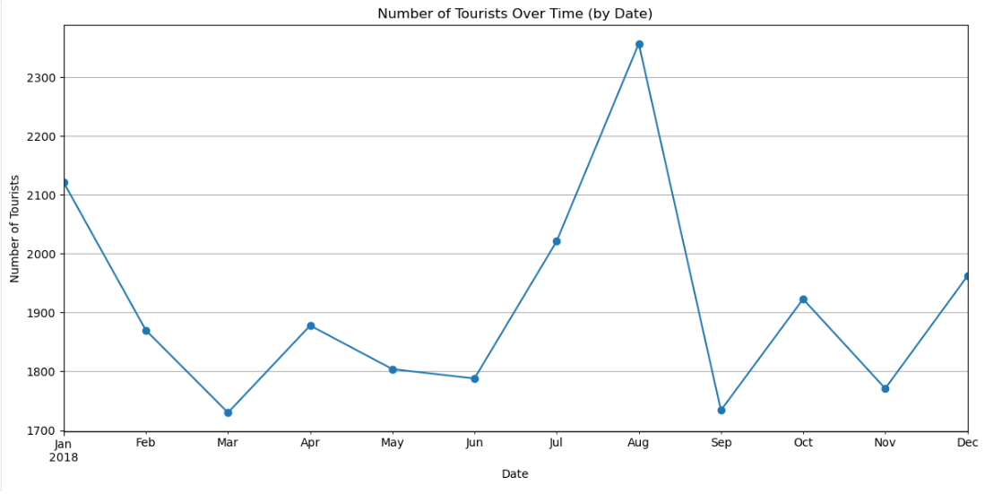
Non Technical – Number of tourist by date

Slide 11
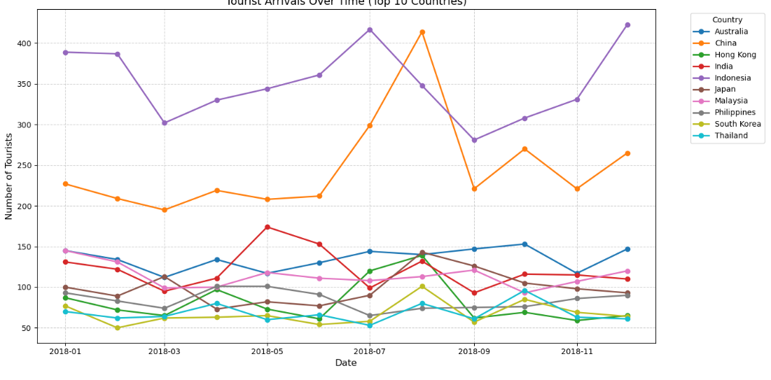
Number of tourist’s residency by date

Slide 12
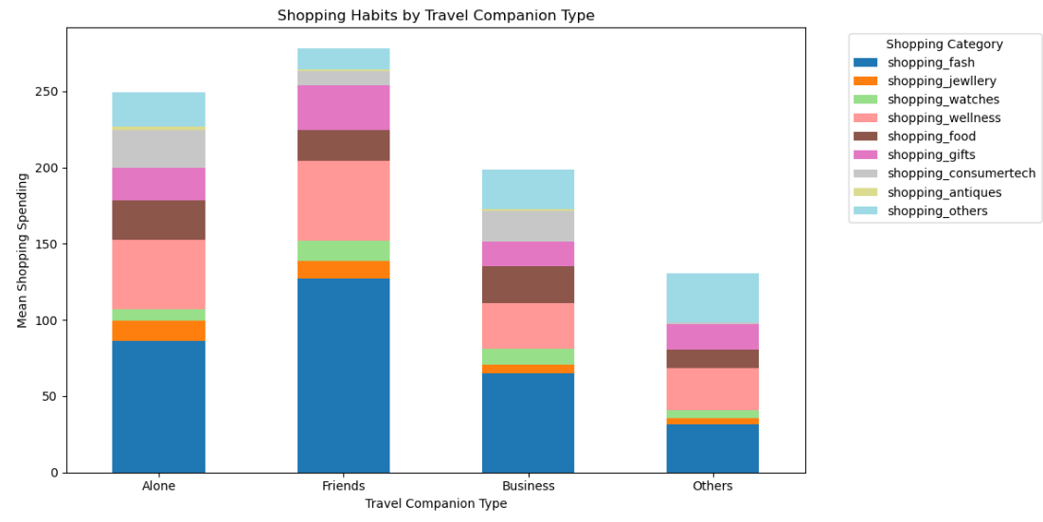
Spending behaviour by travel companion type

Slide 13
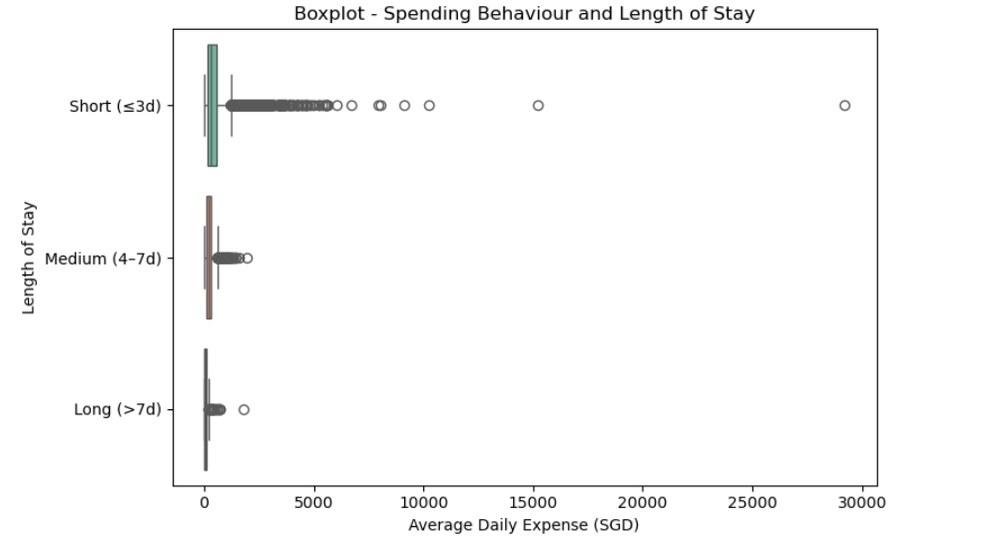
Boxplot –Daily Spending and Length of Stay

Slide 14
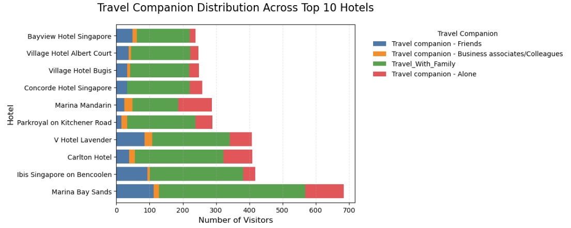
Understanding the relationship between travel companion and type of hotel stayed

Slide 15
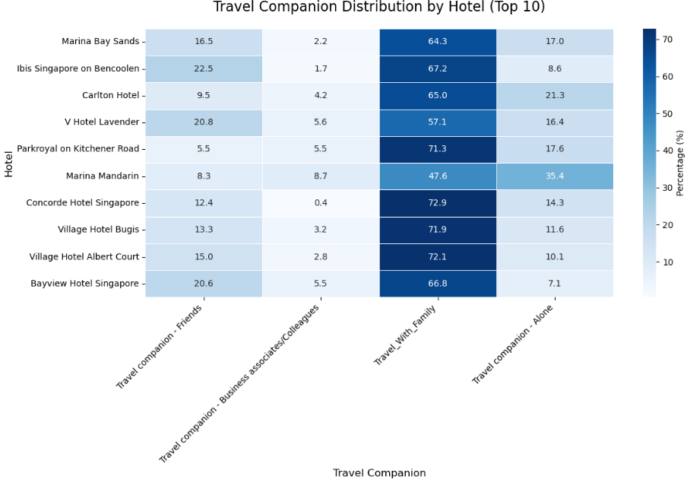
Understanding the relationship between travel companion and type of hotel stayed
Notes:
=== Results === Chi-square: 245.5 p-value: 0.0000 Degrees of freedom: 27 Cramer's V: 0.153

Slide 16
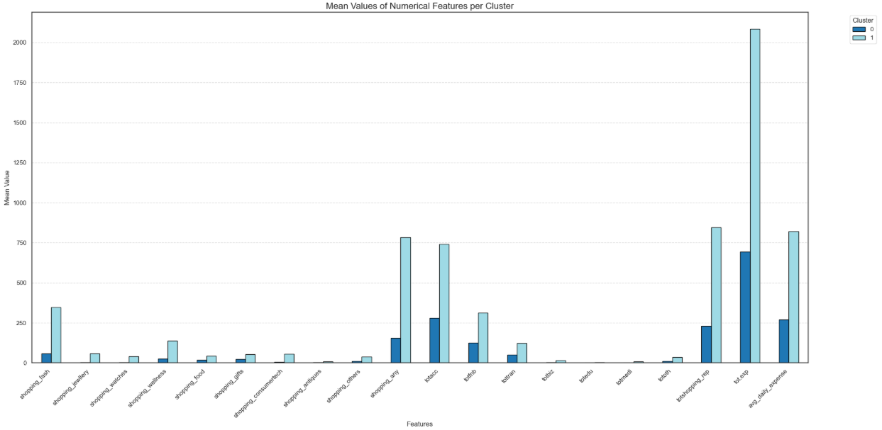

Slide 17
Tourist profile
 | Cluster 0 (Low Spenders) | Cluster 1 (High Spenders)
Trip Length | 62% short stays 35 medium stays | 55% short stays 41% medium stays
Who They Travelled with | 52% Came with family 20% travelled Alone 23% Did not mention | 48% Came with family 35% Alone 13% Did not mention
Main Occupations | 63% working professionals 27% Non working professionals 11% Business owners | 67% working professionals 17% Non working professionals 16% Business owners
Spending profile | Moderate across spending across all domains, with F&B ranked first in terms of spending | 3x times to spend more, tourist in this clusters spend majority of their expenses on fashion, F&B, transport, wellness, and tech

Slide 18
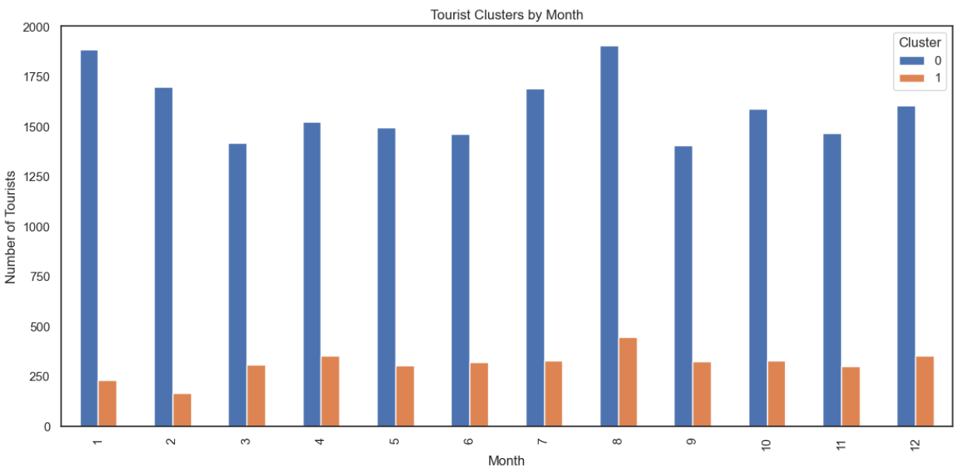
Tourist profile frequency by month

Slide 19
Recommendations
Enhance Access and Navigation from Key Hotels to Shopping Zones
Prioritize connectivity from high-traffic hotels (e.g. Marina Bay Sands, Bencoolen, Carlton Hotel) to nearby retail districts or key shopping precincts via MRT, shuttle, or walkways
Deploy trained guest assistance personnel near hotels and malls to support tourist inquiries. Staff should be multilingual to address potential language
Collaborate with retailers and hotels to deliver wayfinding aids, maps, or digital concierge tools for tourists
Notes:
One area with significant potential to enhance tourist satisfaction and increase spending is last-mile connectivity—specifically, how easily visitors can travel from their accommodation to key shopping and lifestyle destinations.
Prominent hotels such as Marina Bay Sands, Bencoolen, and Carlton Hotel consistently attract high tourist traffic due to their central locations and brand appeal. These hotels are situated near major retail and entertainment zones, making it crucial to provide seamless, intuitive transport links, whether via well-connected pedestrian pathways, nearby MRT stations, or shuttle services.
In addition, we must proactively address a common pain point faced by international visitors: language barriers. Tourists often require assistance with navigation, directions, and recommendations. To meet this need, we recommend the deployment of trained, multilingual guest support staff at strategic points around high-traffic hotels and shopping areas. These frontline personnel will not only facilitate smoother wayfinding but also create a more welcoming and informed environment—encouraging longer stays and greater engagement with local businesses.
This initiative can be further enhanced through digital concierge services, clearly marked multilingual maps, and collaborative efforts between hotels, retailers, and local attractions. Together, these measures will increase both mobility and visitor confidence in navigating the city.
To further elevate the on-ground experience, we also propose strengthening Singapore’s wayfinding and visitor support infrastructure. This includes enhancing the usability of STB’s tourism website and mobile platforms by offering clear, multilingual transport information and recommended itineraries. At key tourist zones, the presence of well-positioned ushers and visible multilingual signage will reduce friction, streamline movement, and allow tourists to spend more time experiencing Singapore—rather than figuring out how to get around it.

Slide 20
Recommendations
Fortify Existing High-Spend Domains Across All Segments
Accommodation is consistently the largest expense for all visitor segments
F&B, transport, and shopping are key common spending areas across segments
Introduce “48-Hour Singapore Experience”: bundled offers including attractions, dining, and shopping vouchers
Partner with travel platforms/agencies to co-develop flight + hotel bundles
Notes:
Our clustering analysis shows that accommodation consistently represents the largest proportion of tourist spending, regardless of segment, while F&B, transport, and shopping also account for significant shares. This tells us that rather than reinventing the wheel, we should fortify and enhance these core tourism pillars.
To do this, we recommend launching a ‘48-Hour Singapore Experience’ package – a curated itinerary that includes attraction access, dining vouchers, and shopping incentives. This is ideal for short-stay visitors, who we found have the highest per-day spend.
Next, we should collaborate with travel platforms/agencies in key markets to develop bundled offers – think flight + hotel + experience in one click.

Slide 21
Recommendations
Strategic Digital Marketing for Key Markets (e.g. China)
Leverage seasonal demand peaks (e.g. July–August travel surge from China)
Deploy geo-targeted ads on popular Chinese platforms such as Weibo, Xiaohongshu, Douyin
Partner with trusted local influencers to showcase Singapore’s experiences (shopping, food, attractions). Engage regional influencers and media to amplify Singapore’s appeal (e.g. highlight family and luxury attractions in Indonesia/China channels
Notes:
One recommendation is to run seasonal, geo-targeted influencer campaigns, especially for high-value markets like China. For example, China typically sees a surge in outbound tourists during July and August. To tap into this window, we propose deploying targeted advertisements on platforms such as Weibo and Douyin, timed about 4–6 weeks in advance to catch the planning phase.
We can amplify this with collaborations with well-known Chinese influencers who already have high credibility and reach within their travel or lifestyle communities. These influencers can highlight curated Singapore experiences – such as luxury shopping, unique dining, and family attractions – through culturally relevant content.
The key is localization: adapting the message, tone, and visuals to resonate with Chinese values and expectations.

Slide 22
Appendix

Slide 23
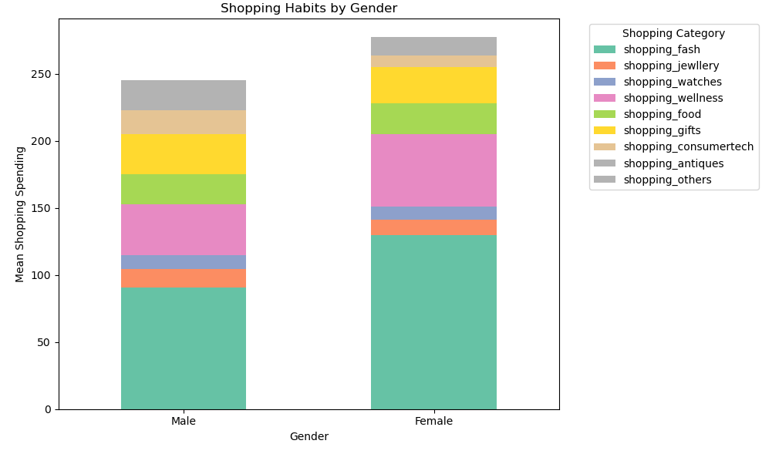
Spending behaviour by Gender

Slide 24
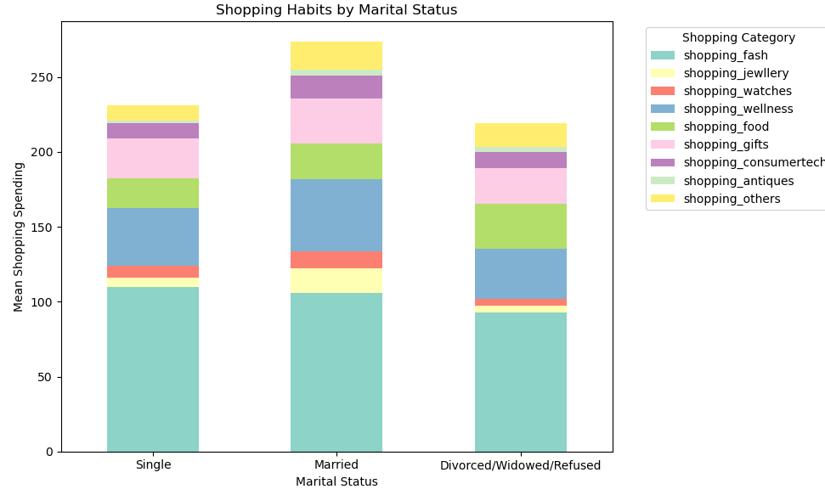
Spending behaviour by martial status

Slide 25
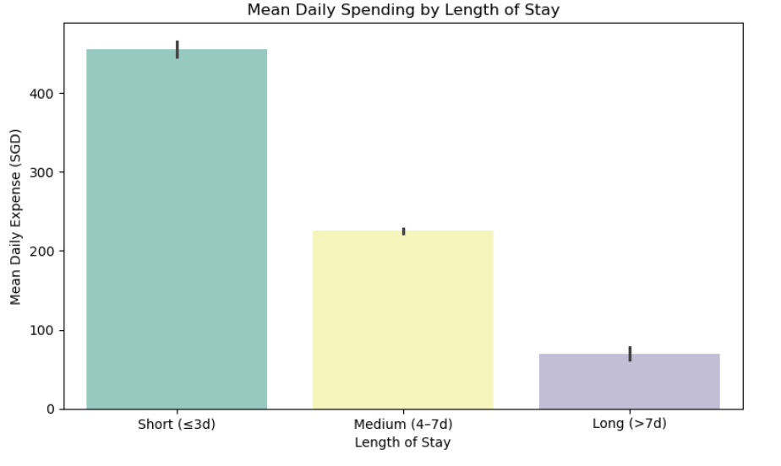
Average Daily Spending and Length of Stay

Slide 26
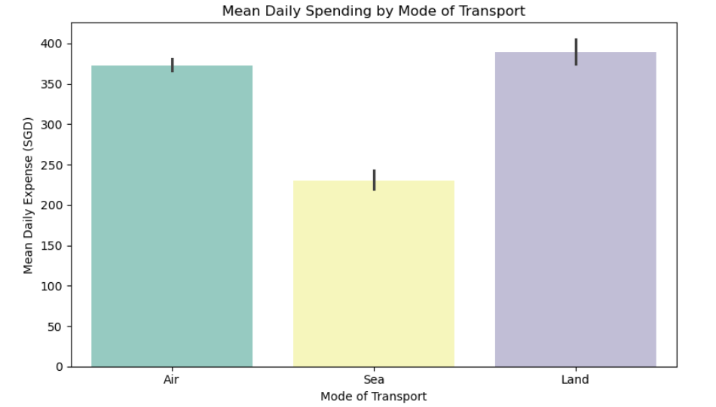
Average Daily Spending by Mode of Transport

Slide 27
Model 1: K means clustering
To understand how are these tourist categorised in terms spending differences and what they spend most on

Slide 28
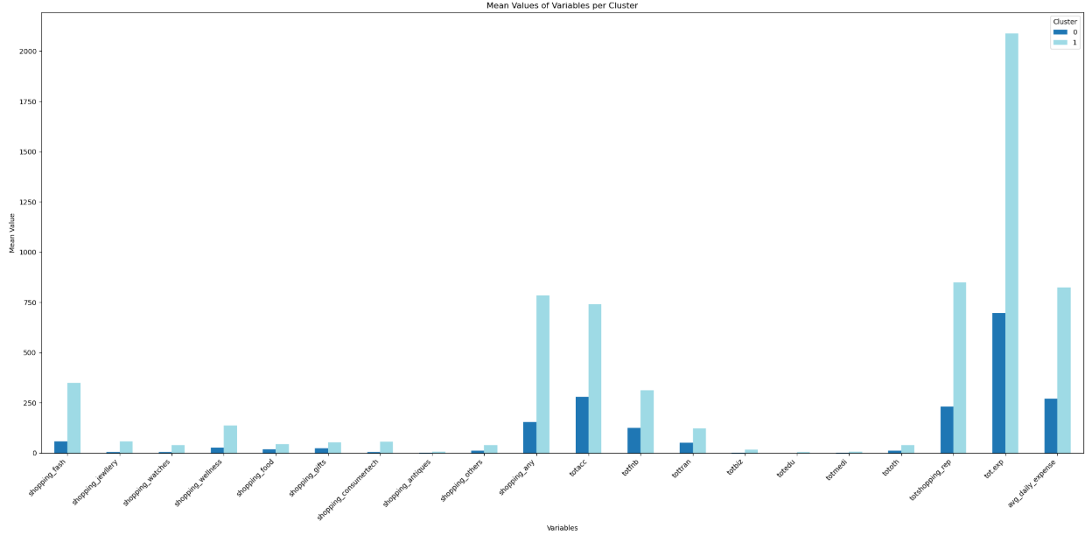

Slide 29
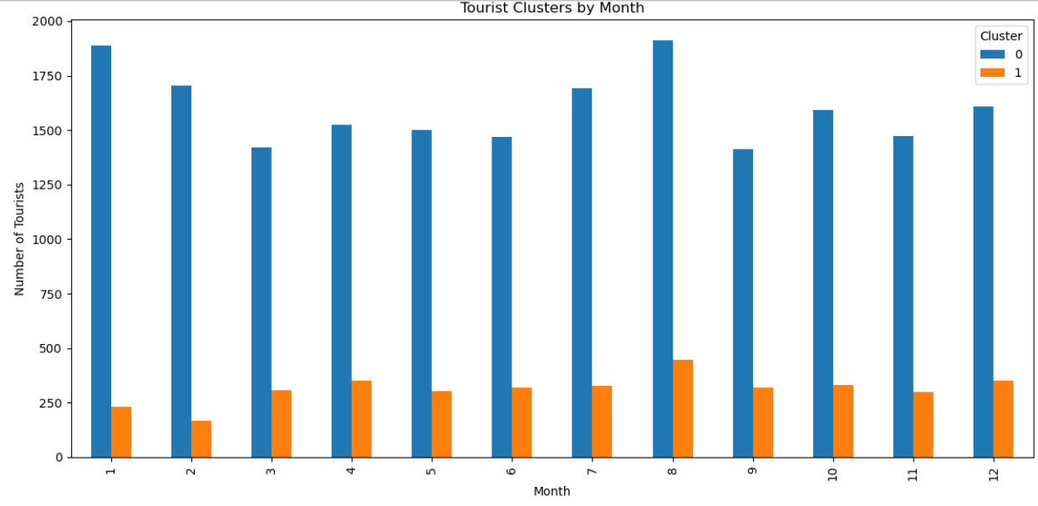

Slide 30
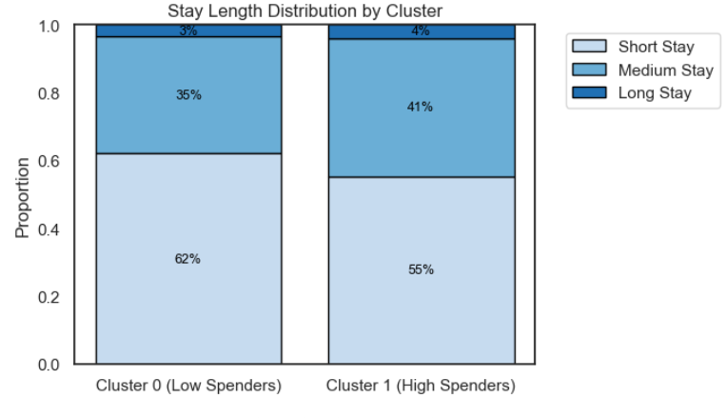
Stay Length Distribution by Cluster (Kprototype analysis)

Slide 31
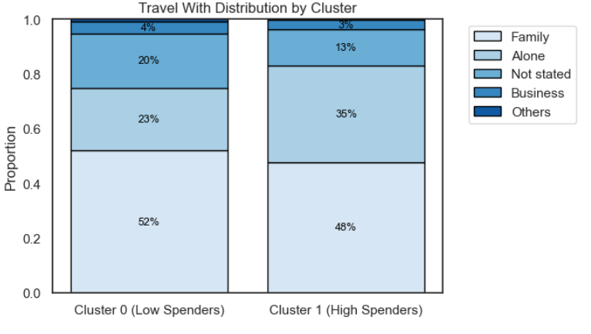
Travel companion Distribution by Cluster (Kprototype analysis)

Slide 32
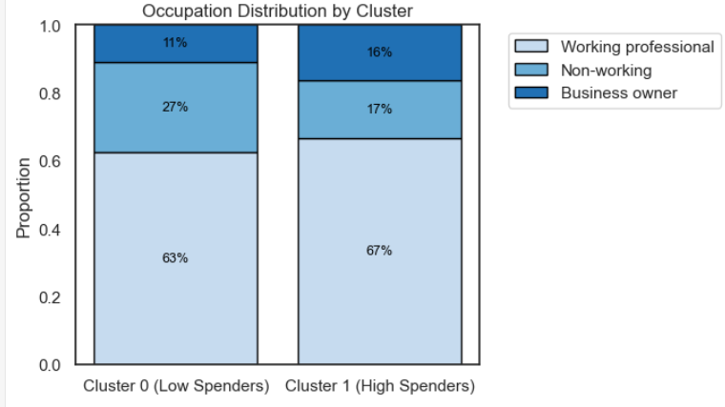
Occupation Distribution by Cluster (Kprototype analysis)

